Slide 1
Multi-Agent Smart Traffic System
Optimizing Urban Traffic Using AI Agents

Slide 2
Problem Statement & Solution
Problem:
Traffic Congestion: Urban traffic congestion is a significant issue, leading to delays, pollution, and excessive fuel consumption.
Inefficiency of Traditional Systems: Static traffic signals fail to adapt to changing traffic patterns and real-time conditions.
Solution:
AI-Driven Multi-Agent System:
Dynamic Traffic Signal Management to adjust signal timings based on traffic flow.
Vehicle Routing Optimization to minimize congestion and improve travel times.
Emergency Vehicle Prioritization ensures emergency vehicles can pass through traffic without delays.

Slide 3
Technical Architecture
System Overview
Multi-Agent System: Consists of different agents that collaborate to manage traffic efficiently.
AI Agents
Traffic Signal AI: Uses Q-learning to optimize signal timing based on real-time traffic data.
Vehicle Routing AI: Routes vehicles to minimize congestion using real-time traffic flow data.
Emergency Vehicle AI: Prioritizes emergency vehicles by adjusting traffic signals dynamically.
System Design:
Event-Driven Architecture: Each agent reacts to changes in the environment (traffic conditions, emergency vehicles, etc.) and communicates with others to ensure smooth traffic flow.

Slide 4
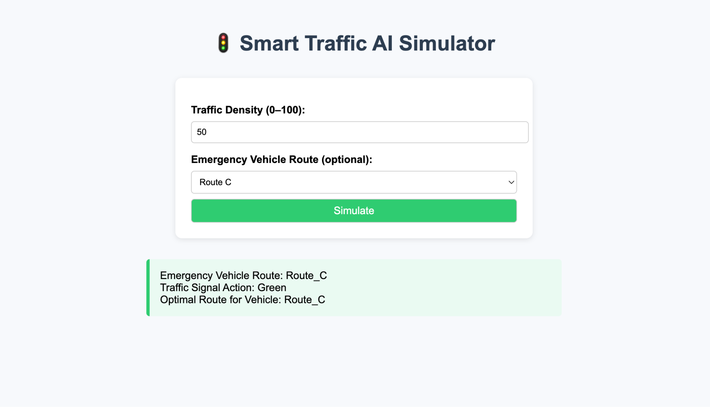

Slide 5
Challenges and Learnings
Challenges
Communication Between Agents: Ensuring smooth, low-latency communication between AI agents.
Fairness in Traffic Management: Balancing priority for emergency vehicles while ensuring fair access for all routes.
Learnings
Message-Passing System: Implemented a robust communication system to minimize delays between agents.
Fairness Balancing: Designed the system to ensure emergency vehicles are prioritized without disrupting overall traffic.

Slide 6
Future Enhancements
Integration with Traffic Sensors: Incorporate city-wide traffic sensors for even more accurate real-time traffic data.
Scaling the System: Expand to larger, multi-intersection road networks for broader coverage.
Advanced AI Models: Use reinforcement learning models for more advanced decision-making.
Vehicle-to-Vehicle (V2V) Communication: Integrate V2V communication to optimize routing based on vehicle-to-vehicle data.

